Slide 1
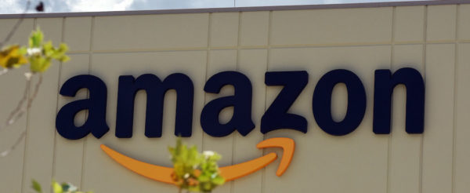
E-Commerce Business Analysis Using Power BI
Kalyan Bandaru 31/05/2026

Slide 2

Problem statement of the Project
Amazon, a company currently performing well in E-commerce sector. The stakeholders wish to maintain this level of performance and seek improvement. For this purpose, they want to devise new strategies. You are part of a team exploring new ways to benefit customers, such as offering more discounts and Prime membership perks. Could you suggest additional methods to identify and reward customers and enhance their shopping experience.

Slide 3
Dataset Overview
OrderDate: The date when the order was placed.
OrderID: A unique identifier for each order.
Delivery Date: The date when the order is scheduled to be delivered.
CustomerID: A unique identifier for each customer.
Customer Age: The age of the customer.
Customer Gender: The gender of the customer (M for male, F for female).
Location: The geographical area where the customer is located.
Zone: Specific zone within the location for delivery purposes.
Delivery Type: The method by which the order is delivered (e.g., Express, Standard).
Product Category: The broad category to which the product belong

Slide 4
Dataset Overview
SubCategory: A more specific classification within the product category.
Product: The name or description of the product ordered.
Unit Price: The price per unit of the product.
Shipping Fee: The fee charged for shipping the product.
Order Quantity: The quantity of the product ordered.
Sale Price: The total sale price of the order.
Status: Current status of the order (e.g., Delivered, Returned).
Reason: The reason for the return or an empty field if delivered.
Rating: Customer rating for the order on a scale (e.g., 1 to 5).

Slide 5
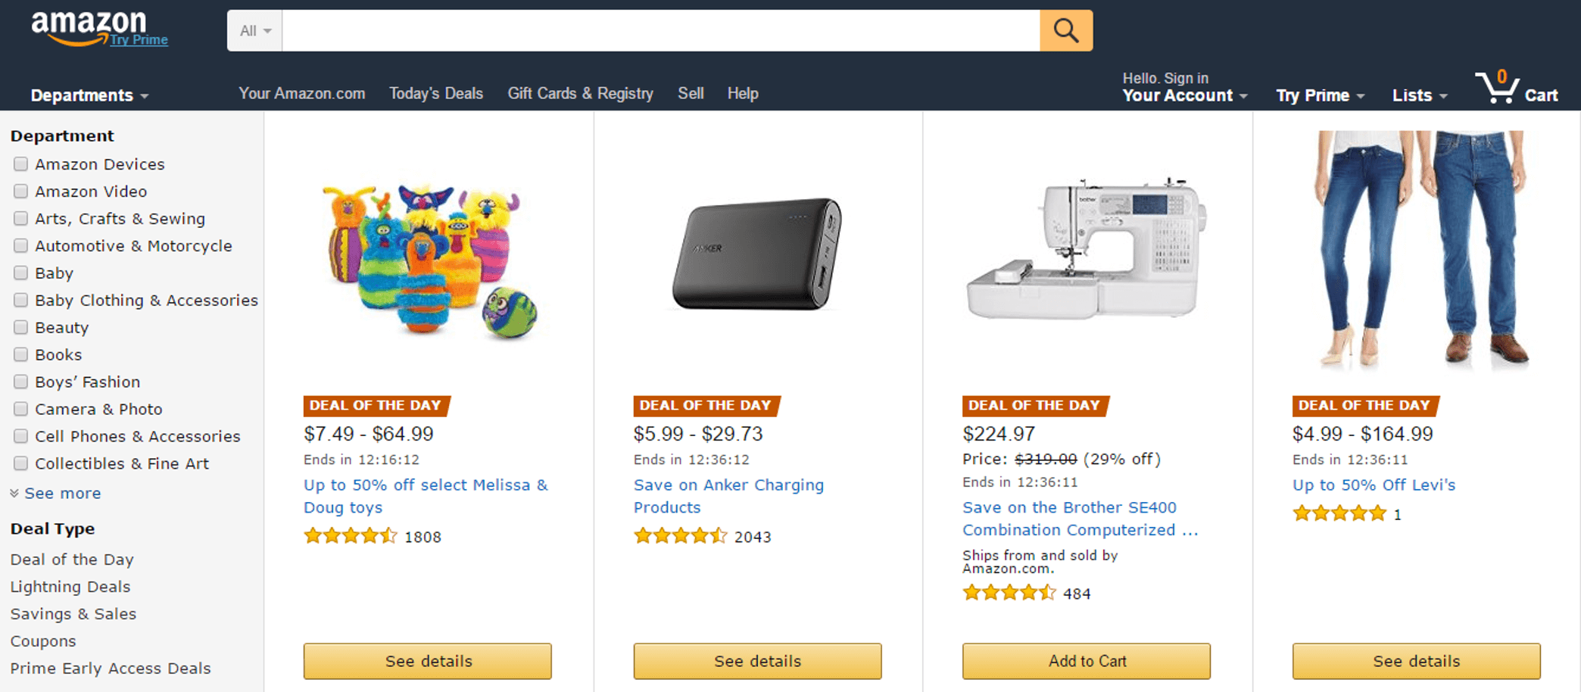
About Amazon E-Commerce Service
Amazon e-commerce is a customer-focused online marketplace built around three core strengths: wide product selection, competitive pricing, and shopping convenience.
Amazon Store says these principles have remained central to making Amazon a go-to destination for customers, with hundreds of millions of products across more than 35 categories and extensive Prime delivery benefits.

Slide 6
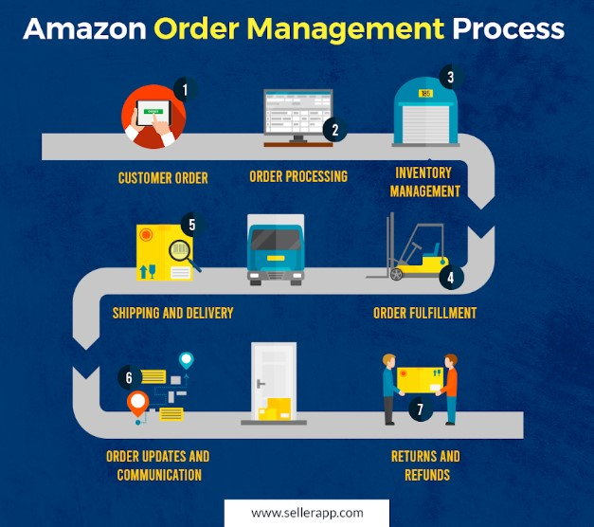
How Amazon E-Commerce
Manages Orders
Order received – Amazon confirms the order and payment in its system.
Pick and pack – Items are picked from the warehouse and packed for shipping.
Sort and ship – Packages are sorted by destination and sent to delivery stations.
Deliver to customer – Orders are routed for last-mile delivery to the doorstep or pickup point.
Returns and refunds – Amazon manages product returns and processes eligible refunds after the return is received or verified.

Slide 7
Analytical Approach of the Problem Statement
Data collection – Collected structured and unstructured data such as orders, browsing history, product views, reviews, ratings, cart activity, and delivery feedback to create a complete picture of customer behavior.
Data cleaning and preparation for accurate analysis – Removed duplicate entries, handled missing values, correct inconsistent formats, and organize the dataset into a usable form so that the analysis becomes reliable and error-free.
Customer behavior analysis to find shopping patterns – Analyzed how customers search, compare, purchase, and abandon products to understand their preferences, decision factors, and pain points in the shopping journey.
Loyal customer identification through segmentation – Segmented customers based on repeat purchases, spending level, recency, and engagement to identify high-value and loyal customers who contribute strongly to long-term business growth.
Improving loyal customers’ shopping experience – Used insights from loyalty and behavior analysis to offer personalized recommendations, targeted offers, better support, and smoother shopping experiences that increase satisfaction and retention.

Slide 8
Key Performance Indicators
113K
Total Unique Customers Count
107.24M
Total Revenue Generated
31K
Total Returned Products Count
44
Total Unique Products Count
9
Average Number of Days for a Delivery

Slide 9
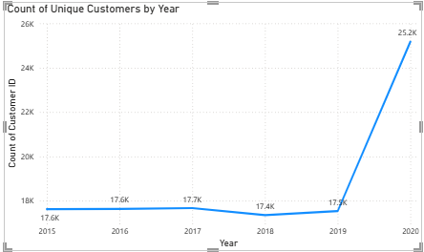
Annual Unique Customer Count
From 2015 to 2019, the count of unique customers stayed consistent with the average count as 17.5K.
But in 2020 the count of unique customers raised to 25.2K.
This raise in customers is due to COVID pandemic.

Slide 10
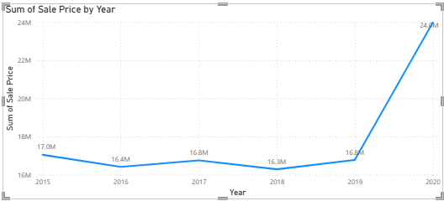
Sales Per year
There has been increase and decrease in sales for all the products over the years.
But in common, all the products were bought more in 2020. Reason could be because of the pandemic.

Slide 11
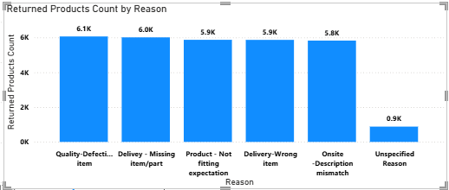
Returned Order Count by Reason
High return rate: 30.53K orders returned (26.85% of total), showing a significant operational challenge that affects revenue and customer trust.
Quality issues are the main cause: 6.1K returns (19.87% of total returns) were due to defective or poor-quality products, calling for better quality control measures.

Slide 12
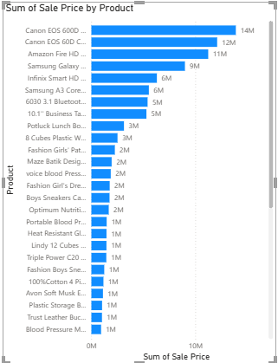
Product Performance Analysis
Top product: "Canon EOS 600D 18MP CMOS DSLR Camera - Black“ - 12.95% of total sales, indicating strong electronics demand.
Lowest product: "Hemani Ultra Slim Tea - 10 Bags" - only 0.01% of total sales, showing minimal customer interest.
Key insight: Sales are highly concentrated in a few products, with electronics outperforming other categories significantly.
Actionable takeaway: Prioritize high-performing products and reassess strategy for low-performing ones to optimize revenue.

Slide 13
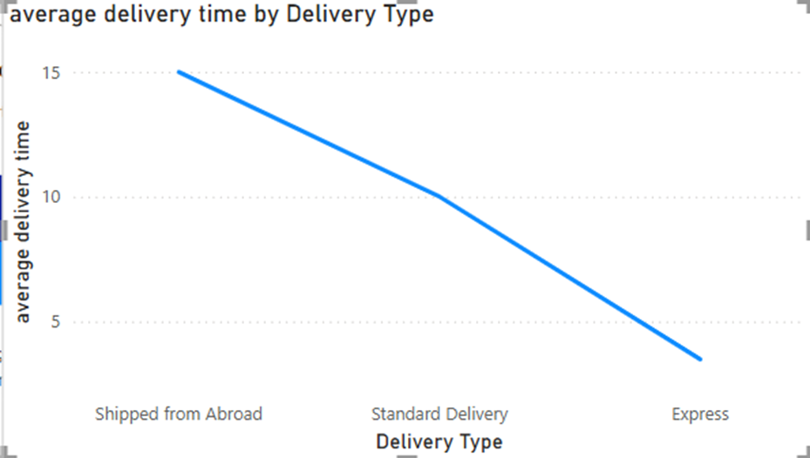
Average Time to Deliver Products by Delivery Type
Express delivery averages 3 days per order, making it the fastest and most reliable option for time-sensitive customers.
International shipping takes 15 days on average, due to customs, longer transit, and cross-border logistics.
Strategic insight: The 12-day difference calls for managing customer expectations and offering faster international options to improve satisfaction.

Slide 14
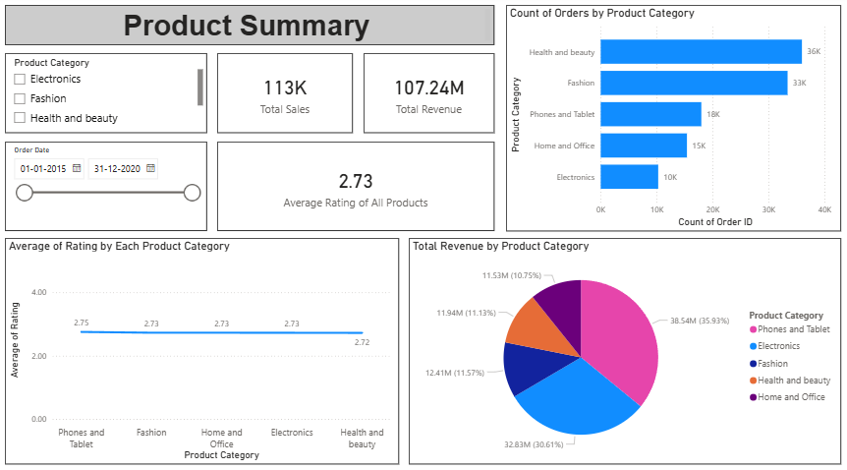
Dashboard

Slide 15
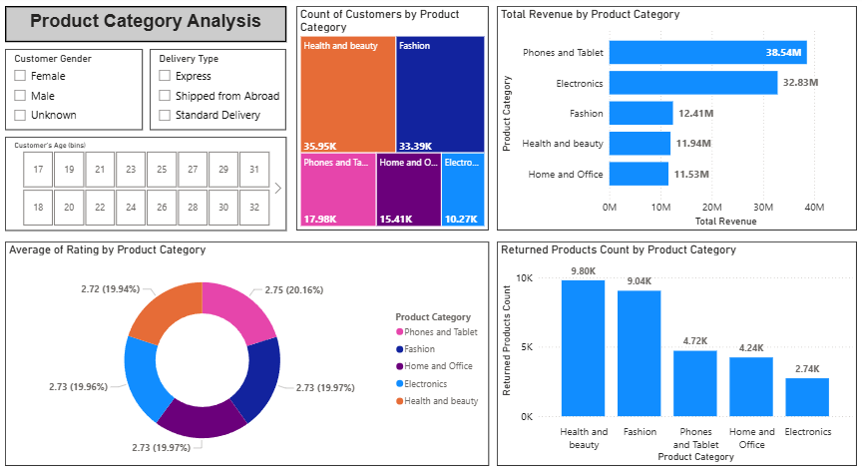
Dashboard

Slide 16
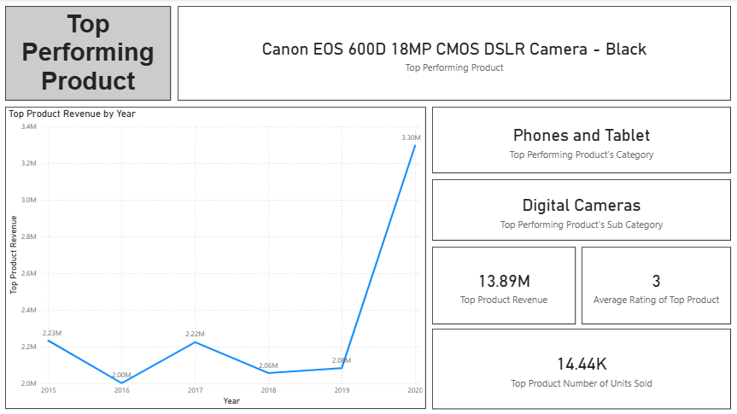
Dashboard

Slide 17
Conclusion
Net revenue reached 78 million, reflecting strong earnings generated from Amazon’s overall sales performance.
Total sales amounted to 107 million, showing significant transaction volume and business scale.
Product returns totaled 31K units, indicating the need to manage return rates for better profitability and service quality.
Average delivery time was 9 days, making delivery efficiency an important factor in customer satisfaction.
Unique customers grew from 2015 to 2018, declined in 2018–2019, and recovered strongly in 2020 with over 8K customers, reflecting changing customer acquisition trends over time.

Slide 18
Strategic Recommendations to Improve Customer Experience
Ship in a well-protected container – Ensure products arrive undamaged using secure packaging to reduce returns and boost customer trust.
Target the right age group – Focus marketing efforts on the most profitable customer demographics to improve conversion and ROI.
Season-based promotion – Align sales campaigns with holidays and seasonal trends to maximize sales opportunities during high-demand periods.
Promote express delivery by subscription – Drive customer loyalty and recurring revenue by offering fast delivery as part of a subscription plan.
Target the right age group – Use data-driven insights to personalize marketing toward the most responsive customer segments

Slide 19


